Slide 1
Innovating Real Estate with Technology: A Vision for Africa and Beyond

Slide 2

Title Slide
Title: Innovating Real Estate with Technology
Subtitle: Driving Inclusivity, Sustainability, and Fintech Integration in Africa and Beyond
Presenter: Adolphe Ishimwe
Date: April 16, 2025

Slide 3
Introduction
The Real Estate Challenge in Africa and Beyond:
Housing Deficit: Africa faces a housing shortage of over 56 million units, with affordability being a key barrier.
Inefficiency: Traditional real estate processes are slow, opaque, and costly.
Financial Exclusion: Over 57% of Sub-Saharan Africa’s population lacks access to formal financial services, limiting access to mortgages and property financing.
The Opportunity:
Leveraging technology and fintech to create inclusive, efficient, and sustainable real estate ecosystems.

Slide 4
The Role of Technology in Real Estate
Fintech Integration:
Provides alternative financing options, blockchain for secure transactions, and digital lending for underserved populations.
2. AI and Data Analytics:
AI offers personalized property recommendations, predictive market trends, and automated valuations.
3. Sustainability and Smart Housing:
Green building technologies and IoT-enabled smart homes reduce carbon footprints and optimize energy use.

Slide 5
Fintech and Inclusivity in Real Estate
Why Fintech Matters:
Expands financial inclusion through mobile money, micro-mortgages, and crowdfunding platforms.
Democratizes real estate investment by enabling communities to pool resources.
Case Study:
StackSource: A global fintech platform connecting real estate investors with tailored financing options.

Slide 6
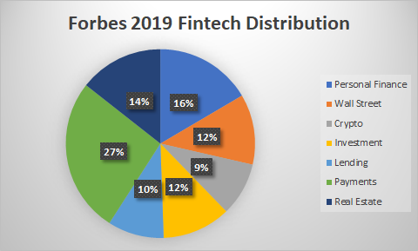
Security and Transparency in Real Estate
Challenges:
Fraudulent property transactions and lack of transparency in ownership records.
Technology Solutions:
Blockchain: Ensures secure, tamper-proof property records.
AI Fraud Detection: Identifies and mitigates fraudulent activities.
Smart Security Systems: IoT-enabled devices enhance safety and provide real-time monitoring.

Slide 7
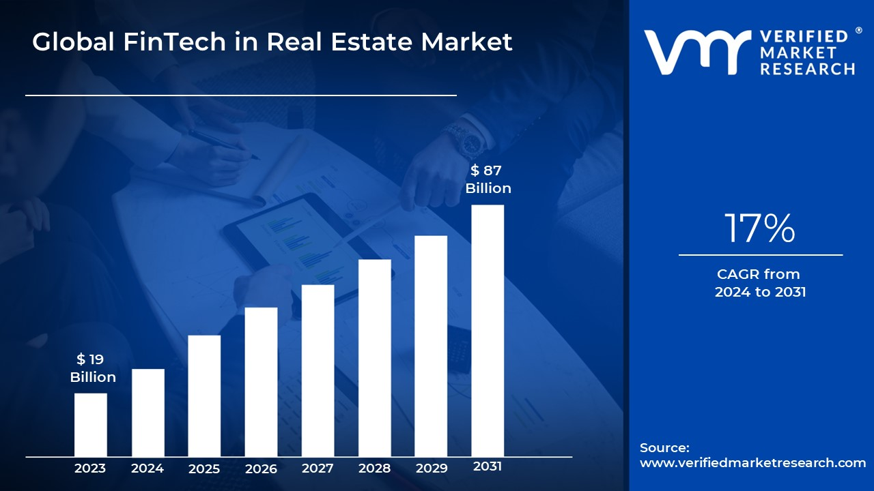
The Future of Real Estate in Africa
Key Trends:
Digital Transformation: AI and fintech will drive efficiency and inclusivity.
Sustainability: Green building technologies will reduce environmental impact.
Smart Housing: IoT and smart technologies will enhance security and energy efficiency.
Projected Impact:
Millions of underserved families will gain access to affordable housing.
Real estate will significantly contribute to Africa’s GDP growth.
Reduced carbon emissions and sustainable urban development.

Slide 8
Call to Action
What Needs to Be Done:
Collaborate: Governments, private sector, and fintech companies must work together.
Invest: Prioritize funding for sustainable and tech-driven real estate projects.
Innovate: Leverage AI, fintech, and blockchain to address Africa’s housing challenges.
Message: Together, we can create a future that is inclusive, sustainable, and secure.

Slide 9

Contact Information
Ishimwe Adolphe
Email: admin@ishimweadolphe.com Portfolio: https://www.ishimweadolphe.com
Phone: +250792491551
LinkedIn:

